Slide 1
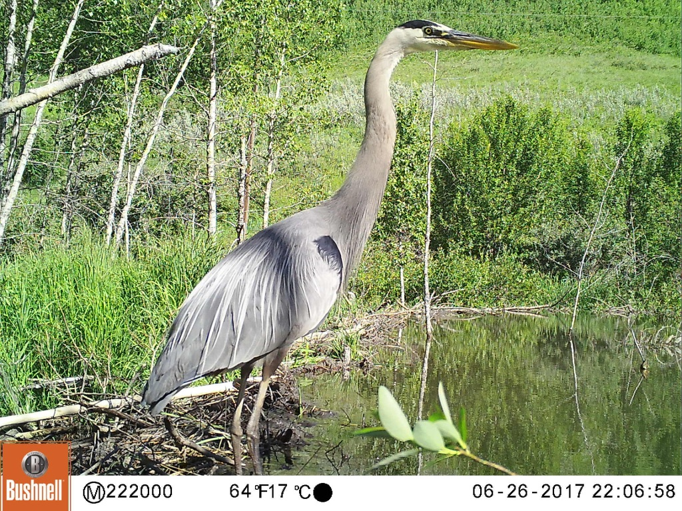
Bighill Creek Preservation Society
Presentation to Town of Cochrane
March 25, 2019

Slide 2
Bighill Creek Drainage
Rapidly eroded during last glacial retreat
Primarily spring fed
Consistent water flow/low temperature
Supports healthy aquatic/riparian habitat
Mostly undisturbed watershed
Generally in good ecological health
Significant asset of Cochrane/Rocky View County
COCHRANE

Slide 3
Primary Aquifer
Pre-glacial channel supplies Big Hill Springs Provincial Park
Creates nationally significant springs and tufa formations
Delivers half of the water supplied to the creek
Extends beyond the topographically defined watershed
Potentially at risk from gravel extraction

Slide 4
BCPS Mission and Objectives
Mission:
“To ensure the natural and historical values of Bighill Creek Watershed
are preserved for this and future generations.”
Objectives:
Maintain and enhance the full range of biodiversity throughout the drainage.
Assess, maintain or improve watershed health, including springs, riparian ecosystem and water quality.
Encourage systems of stewardship throughout the watershed.
Establish a publicly useful repository of ecological, geological, archaeological and historical data.
Educate the public as to the full range of natural and historical values and of their local, provincial and national significance though community engagement and promotion of responsible use.
Create a State of the Watershed Report and Implementation Plan.

Slide 5
BCPS State of the Watershed Report - Actions and Partners
Water Quality and Sediment Analysis (Dr Ymène Fouli)
Riparian Health Assessment (Cows and Fish)
Fish Survey (Trout Unlimited)
Aquatic Insect Study (University of Calgary)
Terrestrial Insect Survey (Funded By Town of Cochrane)
Beaver Management (Misstakis Institute)
Watershed Mapping Project (SAIT)

Slide 6
Rocky View County Municipal Reserves Stewardship
Protect and Enhance the Ecological Integrity of the RVC Reserves
Promote Education and Responsible Use/Trail Signage and Maintenance /Creek Crossing
Engage Adjacent Landowners - to create comprehensive long term plan Ranche Park/ Mt. St. Francis Lands/RVC
Promote the creation of wildlife corridors from adjacent drainages

Slide 7
Our Vision
Incorporate open spaces into Cochrane and RVC plans
Glenbow Park/Bighill and Jumping Pound creeks
Nature Conservancy/WA Ranches /ACA
Promote responsible use
(RVC Parks and Open Space Master Plan 2011)

