Slide 1
Why putting gravel pits near a unique park is not such a good idea: a review of issues and risks
Jon Fennell, M.Sc., Ph.D., P.Geol.
Hydrogeologist & Geochemist
On behalf of the Friends of Big Hill Springs Provincial Park
Bylaw C-8051-2020

Slide 2
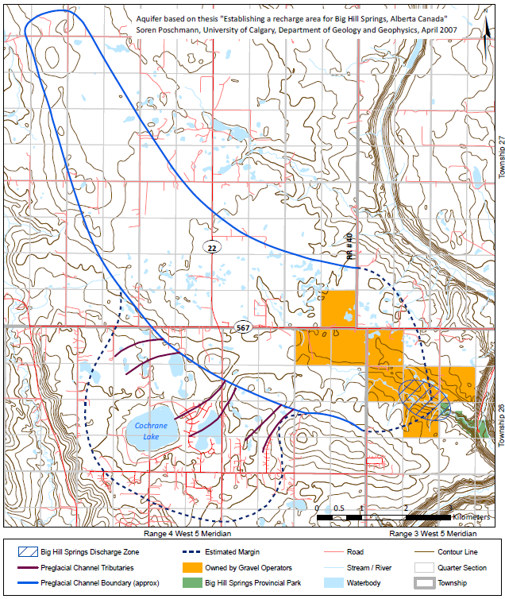
The gravel complex being exploited
It’s big
It’s important
It needs to be protected
feeds Bighill Creek with good clean water of stable temperature (up to 50% of the flow)
Putting gravel pits in sensitive headwater areas are inherently dangerous
Hillstone Aggregates
Mountain Ash LP

Slide 3
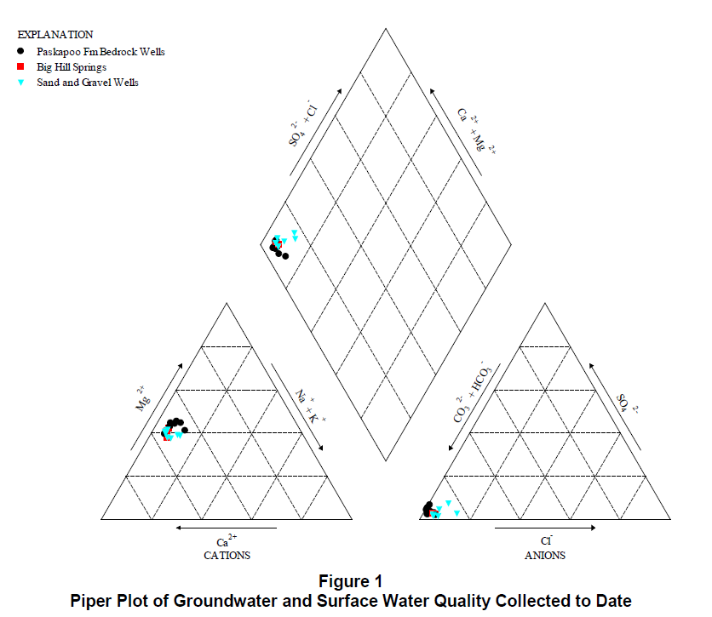
Similarity of waters = connectivity between sand & gravel, bedrock & springs
From SLR 2020 Hydrogeological Assessment Report

Slide 4
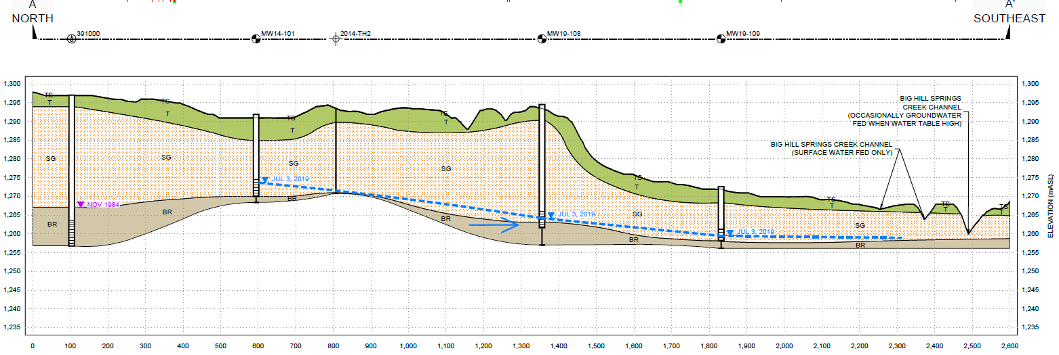
Cross-section through proposed MALP pit
But Big Hill Springs flows all the time…how can it be occasional?
North
South
Inferred

Slide 5
Physical and chemical disruption + removal of filtration = risk
North
South
Flushing by rain and snowmelt
Pit exposed to weathering reactions
spills of fuels/chemicals
leaching of Arsenic; Cadmium; Chromium, Selenium
~300 m/y
Contaminants discharge at springs

Slide 6
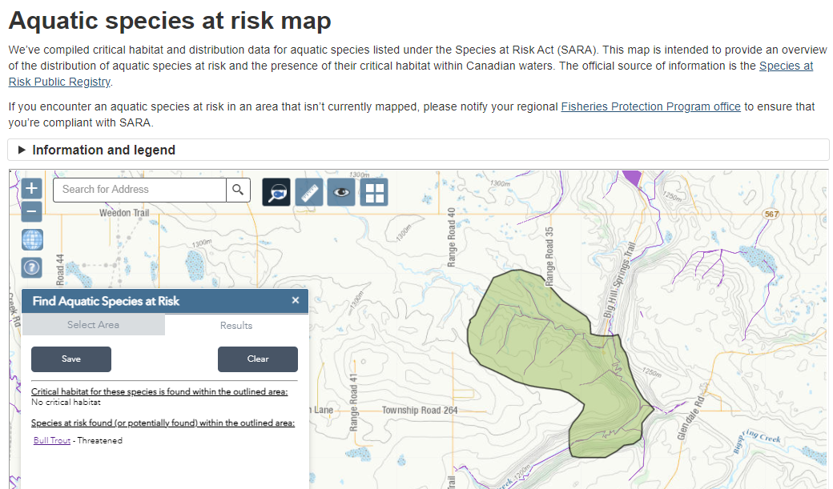
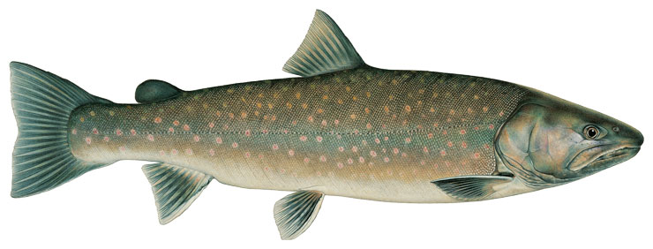
Big Hill Creek & its unique aquatic habitat will be put at risk
By the time contamination is detected its too late
Contaminants discharge into Bighill Creek
No one wants a Fisheries Act violation
Proposed pit disturbance

Slide 7
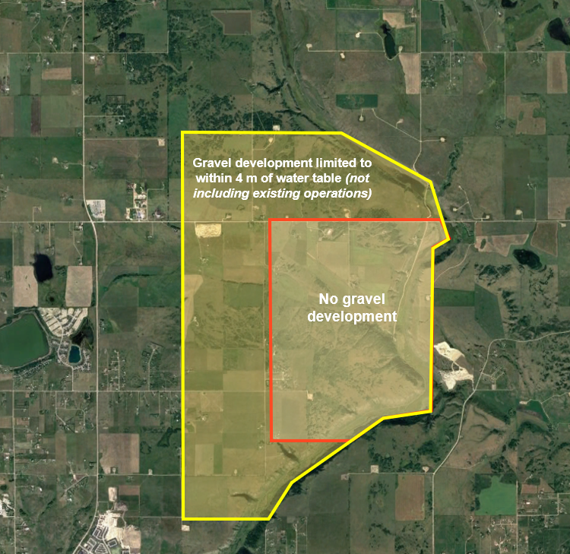
Proposed development setbacks and restrictions
To protect the park, the unique complex of springs, and the habitat that relies on them
It’s a sustainable solution balancing people, profit, and the environment
because there is lots of gravel elsewhere
Make the right choice for the people who love the park

Slide 8
Thank you.

